Slide 2
IEEE EMC Chapter Chair Training
Caroline Chan
Chapter Coordinator
Caroline.chan.us@ieee.org

Slide 3
Agenda
IEEE Vtools training recordings
OU Analytics
IEEE EMC Benefits (includes IEEE EMC DL Videos: Free to members https://ieeetv.ieee.org/ondemand/emc)

Slide 4
Chapter Officer Duties and Center Leadership Excellence
Training Recordings: https://ieee-elearning.org/CLE/course/index.php

Slide 5
Chapter Rebate and how to get more $$$
Website: http://www.ieee.org/societies_communities/geo_activities/required_reporting/rebate_schedule.html
A- Chapter rebate: US$200 for each chapter and MUST MEET minimum requirement (see below) by doing the L50 (filled by the Chapter Treasurer). Contact your section on how to do L50 https://www.ieee.org/societies_communities/geo_activities/required_reporting/financial_reporting.html
Bonus for timeliness: All sections whose reporting (financial, meeting, and officer) is submitted by the third Friday in February 2016 (exact date might change, verify with your section), will receive a 10% bonus of the total rebate.
Activity bonus: In an effort to encourage activities at the local level, activity bonuses may be awarded as follows:
- All chapters or affinity groups reporting six or more meetings shall receive an additional US$75; in the case of a chapter, at least six of the reported meetings shall be in the technical category. To be filled by the Chapter Secretary in L31 meeting reports https://meetings.vtools.ieee.org/main
Section gets: Membership rebate: US$3 for each member, Graduate Student member, Student, or Associate grade member, US$1.50 for each Affiliate, and US$4 for each Senior or Fellow grade member, based on 31 December 2015 statistics.

Slide 6
Get more $$$
B- Angel Funds $600/year to chapter in financial need. Refer to http://www.emcs.org/chapters/haislmaier.html
C – Chapter Awards: http://www.emcs.org/awards_main.html
Chapter-of-the-Year Award ($250)
Most Improved Chapter Award ($250)
Chapter Founder Award (No monetary fund but recognition)
Tip: start organizing the year before to hit your goal
D- Fundraising/mini symposium: contact Janet O’Neil (j.n.oneil@ieee.org) for any advice on how to organize.
Tip: make it annual to keep consistency, else hard to restart. Organize a technical talk + vendors/exhibit

Slide 7
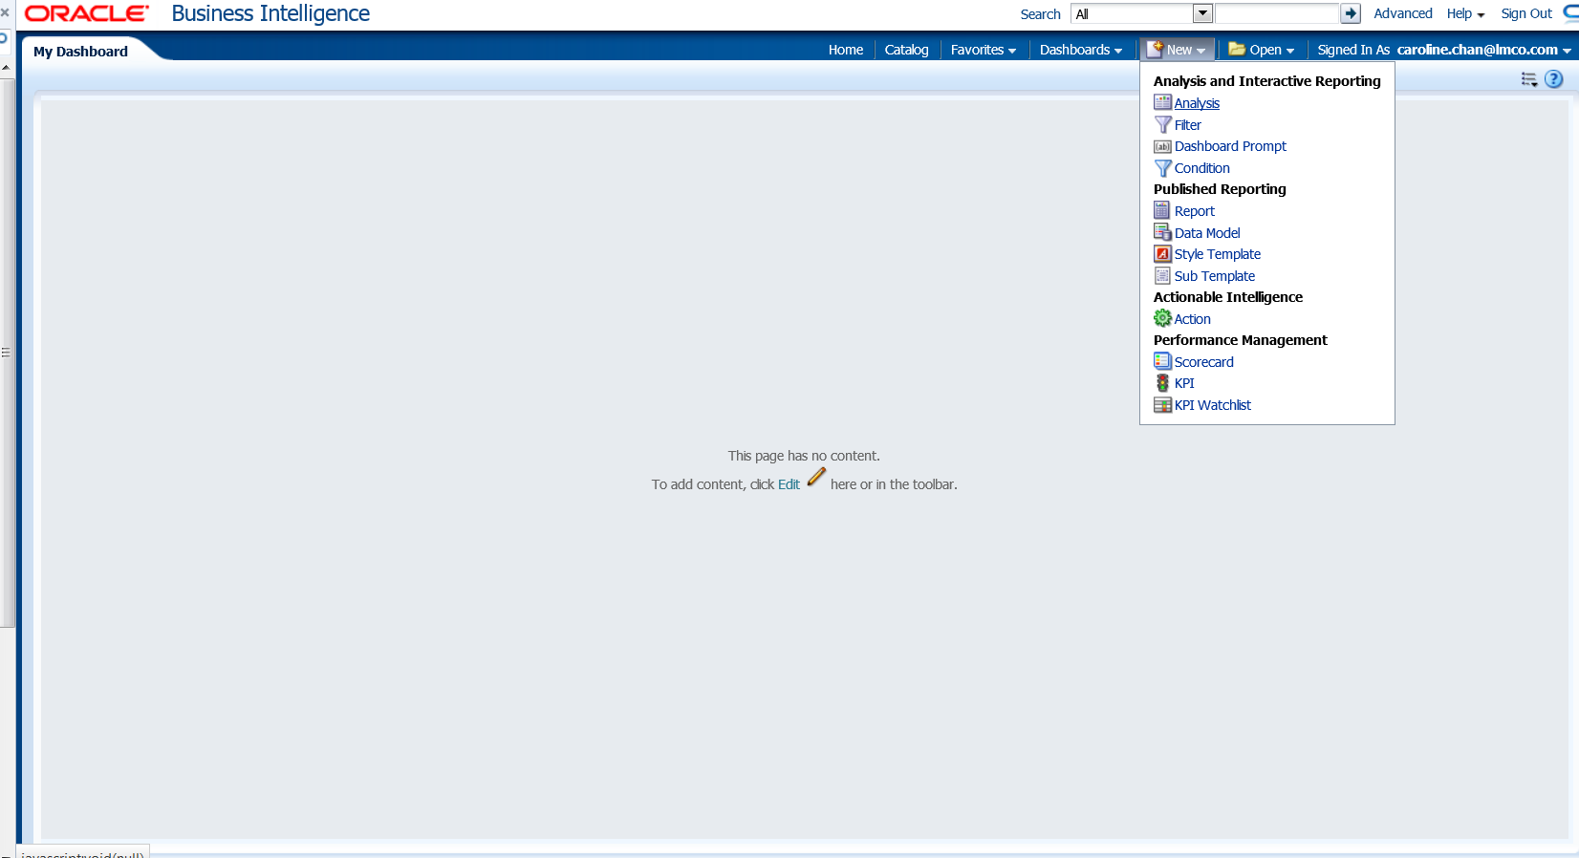
How to Use SAMIEEE
SAMIEEE: how to get the name and email from your chapter: New-> Analysis-> SAMIEEE for Volunteers

Slide 8
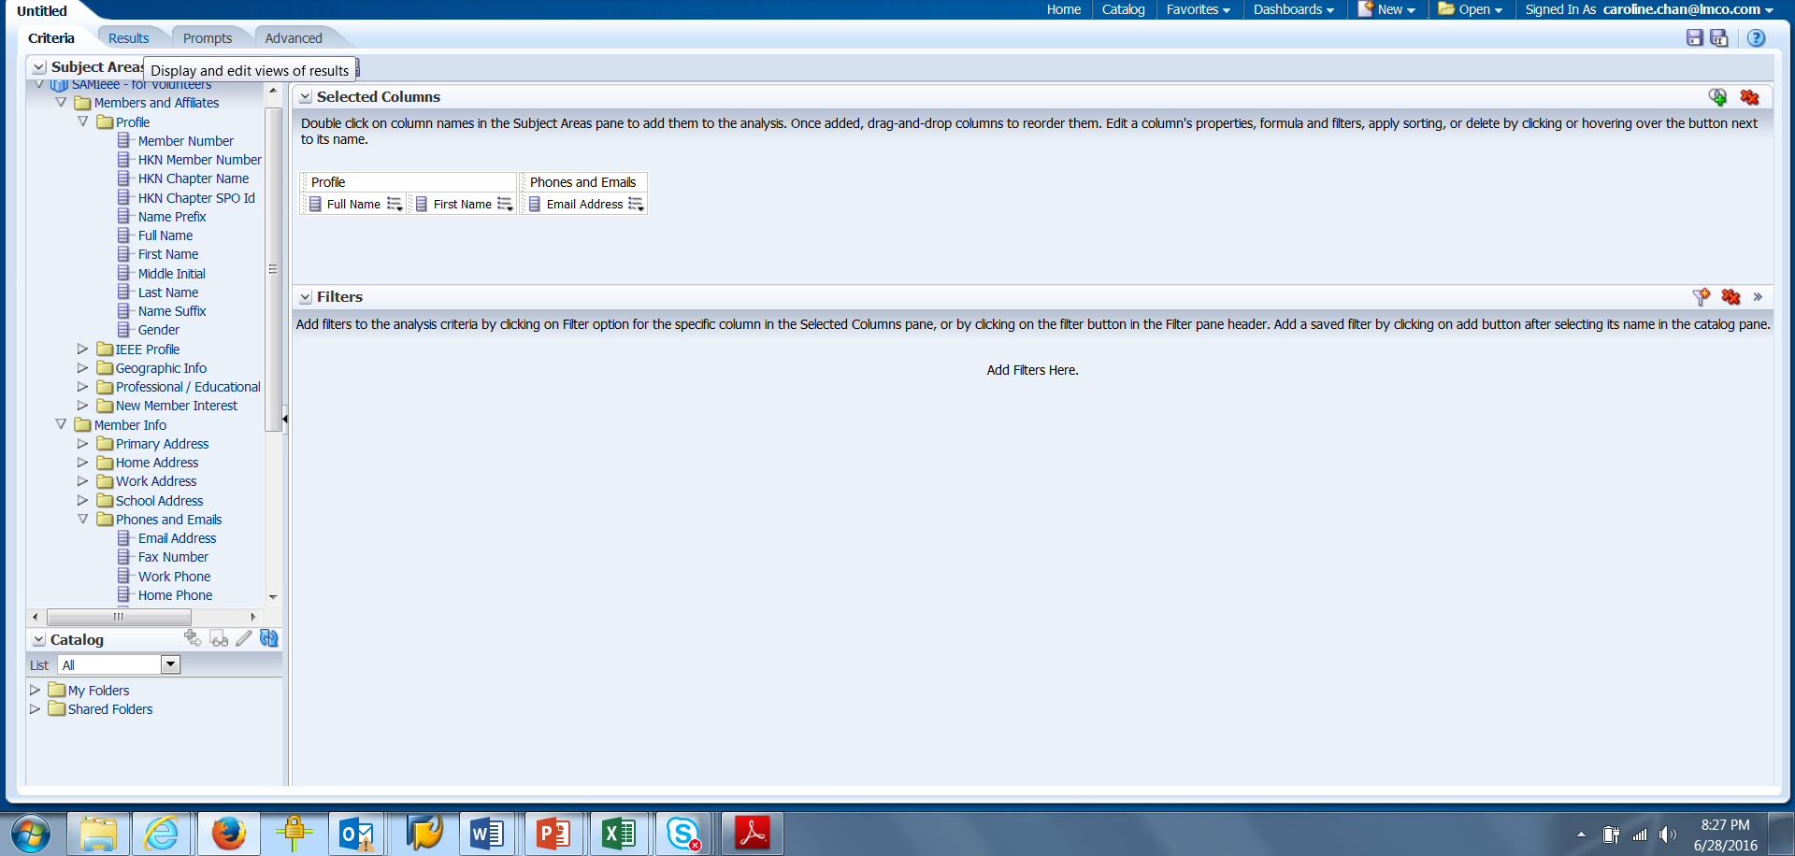
How to Use SAMIEEE
Profile->First, Last (Drop on the right screen)
Member Info-> phone Email (Drop on the right) => Click on the TAB RESULTS

Slide 9
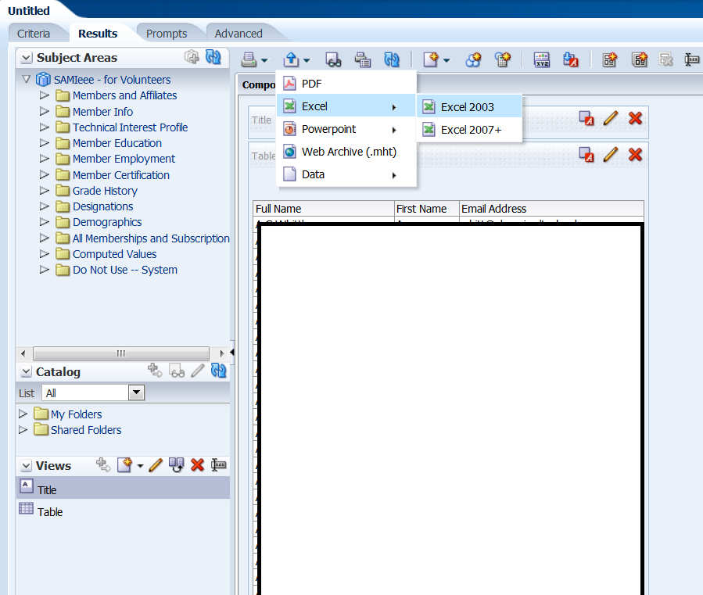
How to Use SAMIEEE
Click on the symbol with Arrow Up to Export.
To understand what each field of the SAMIEEE means, click on this excel document (exacel will merge cells people with the same first name and hard to copy/paste. Instead use .CSV file) OR Data-> .CSV

Slide 10
OU Analytics replaces SAMIEEE
SAMIEEE to retire May 25th 2018
OU Anlytics: better visualization and a business intelligence
http://www.ieee.org/ouanalytics
Need to agree on the IEEE Data Access (sent via email by IEEE)

Slide 11
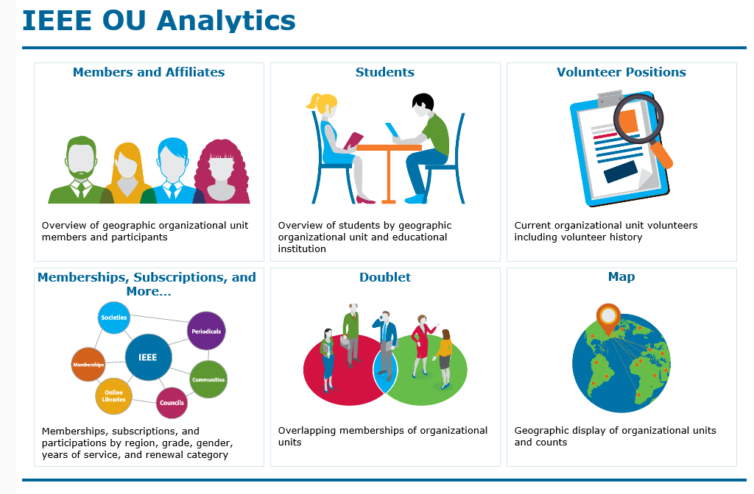
Dashboard

Slide 12
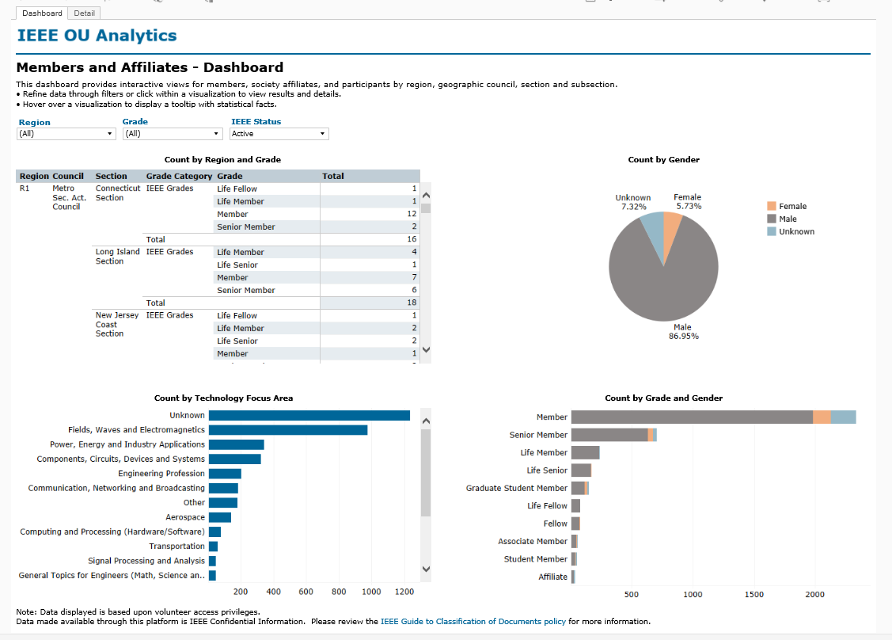
IEEE OU Analytics

Slide 13
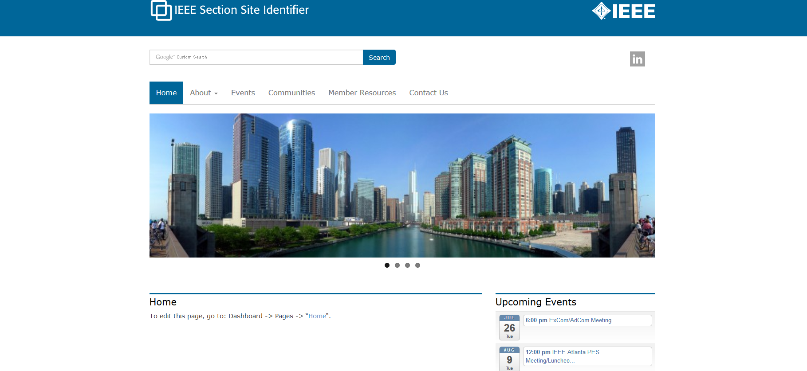
Wordpress (1 of 4)
Template and Host:
Based on IEEE Template, no programming experience necessary
This is what the template will look like: http://sites.ieee.org/section-template/
Request the template and for IEEE host: http://sites.ieee.org/hosting/wordpress-hosting/
(you can add other users later once you become the Admin)
If you haven't heard from IEEE within a week, please contact Khanh Luu k.n.luu@ieee.org
Khanh is the Sr. Information Management Analyst of the IEEE Member and Geographic Activities
Department (MGA)

Slide 14
Wordpress (2 of 4)
Officers updates on Wordpress:
Once the website is up (with login):
http://sites.ieee.org/wnv-emcs/about-ieee/executive-committee/
and
http://sites.ieee.org/wnv-emcs/communities/
are automatically updated for you. To update the officer information use http://officers.vtools.ieee.org/.
To update the communities page, please contact Khanh Luu k.n.luu@ieee.org
Website Updates:
Once you have the login, make the updates by doing to
dashboard-> pages-> select the page you want to edit->type the
information and click on UPDATE (not preview since the "preview" function is not working).
Luckily if you do not like what you just updated, you can always choose the previous revision and go back
to it.

Slide 15
Wordpress (3 of 4)
Meeting calendar updates:
Note that for the calendar, you can go get your URL meeting from the L31
https://meetings.vtools.ieee.org/main
(go to "schedule meeting) to update the RSS feeds. Please take a look on the documents provided in the
Ppt attachment for Wordpress Feeds for step by step instruction. It is easier for the chapter to set and
also a push for the chapter to input their incoming meeting early and hopefully complete the L31 early also.
You can change the "IEEE section identifier" (left corner) by going here
(and you can put the EMC society logo or add your own chapter one) once you have the login and change
the highlight part
of the link to your particular chapter website link (replace “wnv-emcs” with your chapter name) http://sites.ieee.org/wnv-emcs/wp-admin/customize.php?return=%2Fwnv-emcs%2
Fwp-admin%2F&autofocus%5Bcontrol%5D=header_image

Slide 16
Wordpress (4 of 4)
Download IEEE Sites theme tutorial file at
https://drive.google.com/open?id=0B_i1MnQg-aYveXFtODFheFhXR1k&authuser=0.
You also check out the WordPress tutorials presented by Lance McBride and Ed Perkins at:
Session 1 – Fundamentals – Basic WordPress interface and structure, Templates, Calendar
http://research.microsoft.com/apps/video/default.aspx?id=242111
Session 2 – Intermediate - Metatags, Plugins, vTools Calendar, Forms, Surveys,
Promo Images, Redirections, ecommerce)
http://research.microsoft.com/apps/video/default.aspx?id=242109

Slide 17
What’s new with the EMC Society
IoT participation along with other IEEE Societies (collaboration/have a stake): EMC Contributor Mike Violette (DC.Northern VA Chapter Chair)
IEEE EMC Women-In-Engineering (WIE)
A Practical Paper Journal is being discussed as a separate electronic only and/or print publication. This would include application oriented papers or papers presenting case-studies.
Calling for Participation into the TCs: (Technical Committees) and PACE-IEEE USA (Professional Activities Committees for Engineer BUT it is not just about USA). For more PACE information, contact Kimball Williams (k.Williams@ieee.org) https://www.ieeeusa.org/volunteers/pace/
IEEE USA: free e-book every quarter: check your email and resend to your members
Student Liaison: Joseph Vas (Bangalore) j.v.vas@ieee.org
Young Professionals (Starting Term 2018): Louann Devine ieeeypemc@gmail.com

Slide 18
Who will you work with and How
Note: This table is NOT a 1-1 answer
WHO | How | Link
Section
YPs (Society AND Affinity Group) Students/Student Branch Chapters (SBC) | Presentation (with food), Social Activities | Be a Speaker at the SBC/YP/WIE session Congress. R8 (once every 2 years, summer), R9 (once every 2 years), R10 (every year, summer), R6 (once a year at Las Vegas before CES in January) Get involved with IEEE STEP (Student Transition & Elevation Partnership) such as be a panelist at a College through their Student Branch. https://www.ieee.org/societies_communities/geo_activities/volunteer_recruitment_toolkit.html
Sister Societies | IEEE TV | https://ieeetv.ieee.org/
EMC Associations, Universities, City Council | Professors, Open House, presentations (with food) | webinar series – Young Professionals https://www.ieee.org/membership_services/membership/young_professionals/events/index.html
Active members, Section | eNotice (vtools) = Newletter sent to all your members (automatically add new members) | http://www.ieee.org/about/volunteers/enotice/enotice_index.html
 | Collaboractec for volunteers | IEEE Collaboratec https://ieee-collabratec.ieee.org/),
Distinguished Lecturer , engage successful people in the industry |  | http://www.emcs.org/dl-main.html
EMC Society |  | Depends on the need, contact appropriate officer
Technical Advisory Committee |  | http://www.emcs.org/committees/tac/
Technical or professional Activities | Angel Funds (for needy chapters) | http://www.emcs.org/chapters/haislmaier.html
Companies (EMC Test labs, local industry) | Sponsorship/fundraising/mini symposium | For food during meetings or annual sponsorship and recognize them,

Slide 19
Example of eNotice
Lots of valuable information inside for volunteers and Awards

Slide 20
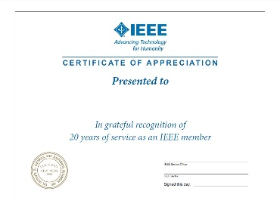
Retain and Rejuvenate
Membership Deactivation/Arrears (SAMIEEE using vtools up to May 25th/ OU Analytics starting now)
Associates to Member: http://www.ieeer8.org/category/membership-development/
Senior Member Elevation IEEE Senior Elevation
Membership Discount/ referral
(IEEE Membership Referral and Discount (new Members to IEEE))
Survey
Loyalty Pins (recognize new and long time members) IEEE Loyalty Pin Program
Certificate of Recognition and Award (individual, section, and companies, friend of IEEE (does not have to be a member))
MGA Award and Recognition Program
IEEE USA Award Program (Professionalism and Technical awards)
Title (not volunteer but Webmaster or Director of Social Media, title provides the importance of the position and Recognition)
Sponsor a potential (active) volunteer to an event
One-day seminar (with or without exhibitor, fees or no fees for admission) – meet new members/good speakers
Mentoring
Social media/Translate material in the local language
Change of venues and presentation style (museum, outdoor, etc)

Slide 21
Benefits
Leadership/Management Role/Do something you don’t have the opportunity to do it at work/school
Good Young Professionals List so that YP volunteers can go to different positions by nomination from other people that might not know this person http://yp.ieee.org/volunteers/good-young-professionals-list/
Hundreds of Volunteer Roles among IEEE (not just EMC)
Technical/Professional presentation/publication (https://ieeetv.ieee.org/ondemand/emc some free lecturers for EMC Members and fees for non EMC members)
Job and Internship Opportunities (IEEE Collabratec https://ieee-collabratec.ieee.org/)
Job Fair (tag along with local events)
Networking with people in the same field, professional development
To be exposed to new technology as well as established tech
Discount on Conference fees, symposium proceedings
Increase self-esteem
Non technical benefits like insurance

Slide 22
Benefits
Scholarship (Scholarship Grant and Fellow (might be specific to society) and also ask your section if they offer any particular ones for local Universities)
IEEE Competition (EMC for Student Hardware, contact ESAC)
IEEE Mentor Center:
http://www.ieee.org/membership_services/membership/mentoring/index.html
Resume lab: http://www.ieee.org/membership_services/membership/resumelab.html
Develop your resume or curriculum vitae (CV)
Letters (cover letter, thank you letter, etc)
Portfolio of work
Skills assessment
Mock Interview (you can record yourself)
Video Resume to potential employers

Slide 23
A Real Story from the IEEE Young Professionals:
from Graduation to a satisfying job
https://www.ieee.org/societies_communities/geo_activities/sections_congress/2014/sc2014_enhance_embracing_young_professionals.pdf

Slide 24
Collabratec
https://ieee-collabratec.ieee.org/
What is Collabratec?
The IEEE Collabratec Branding and Communications Toolkit is a marketing resource for promotions and communications in connection with IEEE Collabratec. This toolkit explains how to use IEEE Collabratec brand elements and offers resources for creating strong and consistent communications pieces while supporting the IEEE brand.
Targeted at both IEEE members and non-members, including authors, researchers, and volunteers, IEEE Collabratec helps users:
Connect with global technology professionals by location, technical interests, or career pursuits
Access research and collaborative authoring tools
Establish a professional identity to showcase key accomplishments
IEEE Collabratec also helps IEEE volunteers:
Build and manage their IEEE volunteer network
Build communities and engage technology professionals in real time
IEEE Collabratec competitively positions IEEE for the future of publishing, professional networking, and career development. IEEE Collabratec brings together IEEE and non-IEEE individuals – whether they are authors, publishers, IEEE members, or other technical professionals who have similar interests – through an integrated online community, facilitating collaboration and connectivity. All in one centralized hub, IEEE Collabratec offers these major features:
Online communities
Author and researcher tools
Career development networking opportunities

Slide 25
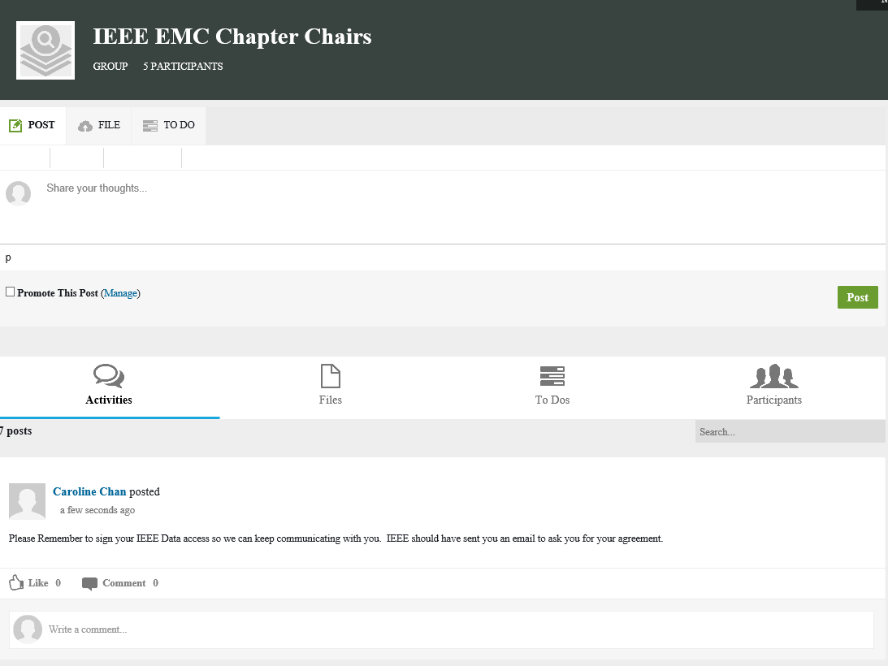
Collaboratec
Used as a working forum for a small group. Does NOT work for the public.
You can create a group, upload a document for review.

Slide 26
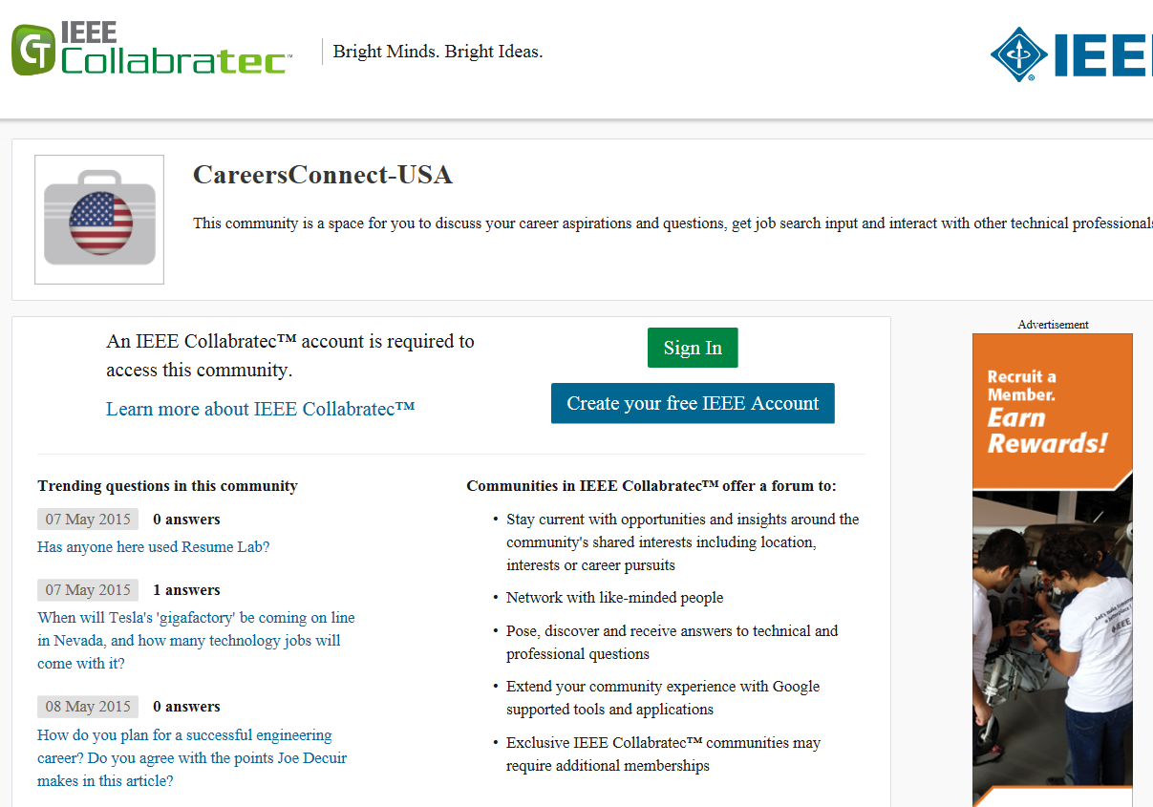
Collaboratec

Slide 27
Collaboratec: Job Opportunities

Slide 28
Questions?
Thank you

